Slide 1
Literature Survey on Metaphor and Idiom Detection in Large Language Models
Manjusha Motamarry Margi Shah

Slide 2
Table of contents
01
05
02
06
03
07
04
08
Abstract
Challenges
Introduction
Comparative Analysis
Methodology
Critical Analysis
Conclusions
Thematic Analysis

Slide 3
Abstract
Overview:
This survey explores advancements in metaphor and idiom detection using large language models (LLMs), emphasizing their impact on figurative language understanding.
Key Findings:
Models like MelBERT and NewsMet improve detection but face challenges in reasoning and contextual understanding.
High-quality datasets like FLUTE, MUNCH, and NewsMet drive progress but lack multilingual diversity.
Challenges:
Difficulty interpreting complex figurative expressions.
Limited adaptability in low-resource and multilingual settings.

Slide 4
Introduction
Background:
Figurative language, including metaphors and idioms, is a fundamental aspect of human communication, adding creativity and depth. Detecting and interpreting these expressions is critical for NLP tasks such as translation and sentiment analysis.
Objective:
To examine advancements in metaphor detection, explore domain-specific applications, and address key challenges in multilingual adaptability and reasoning.
Scope:
Focuses on research between 2020 and 2024, emphasizing peer-reviewed works that highlight state-of-the-art contributions, including datasets, methodologies, and applications in news, literature, and religious texts.

Slide 5
Methodology
Search Strategy:
Research was collected using databases like ACL Anthology, IEEE Xplore, and Google Scholar. Key phrases like “metaphor detection” and “idiomatic expression translation” guided the search.
Selection Criteria:
Peer-reviewed papers published between 2020 and 2024 were prioritized. Studies introducing innovative models, datasets, or evaluations in figurative language were included.
Emphasis:
Focused on methods leveraging LLMs and linguistic theories, with special attention to multilingual and low-resource applications.

Slide 6
Thematic Analysis
Datasets: FLUTE, NewsMet, and MUNCH enable metaphor detection and interpretation; gaps exist in multilingual and low-resource settings.
Techniques: Models like MelBERT and IlliniMet leverage PLMs and linguistic features; challenges include generalization and reasoning.
Interpretation: Reasoning with figurative language remains limited, even in advanced models (e.g., GPT-4).
Applications: Cross-lingual and domain-specific studies show promise but face cultural and contextual challenges.
Key Insight: Progress continues, but gaps in reasoning, generalization, and multilingual capabilities persist.

Slide 7
Comparative Analysis
Results, Datasets, and Methodologies

Slide 8
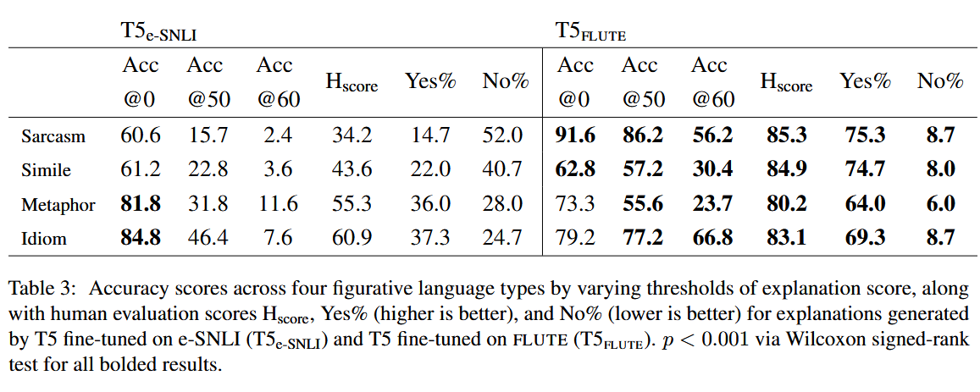
FLUTE: Figurative Language Understanding through Textual Explanations
This paper employs an explanation-based NLI approach with GPT-3 and crowd annotations, achieving 81.8% accuracy for metaphors and 79.2% for idioms.

Slide 9
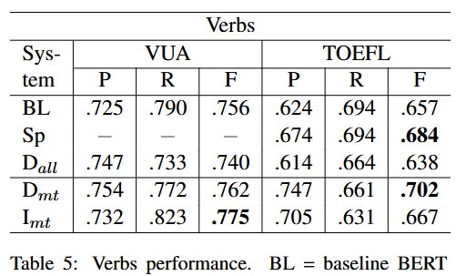
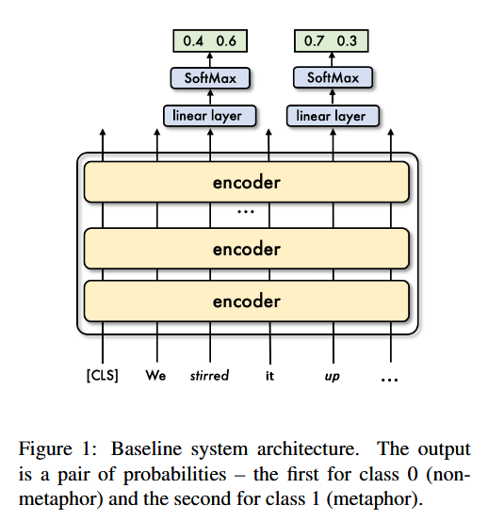
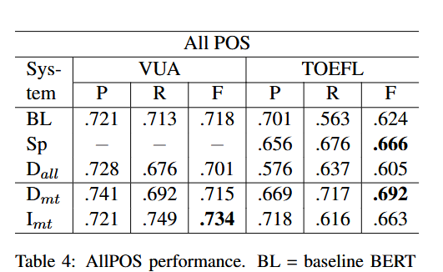
Go Figure! Multi-task transformer-based architecture for metaphor detection
This paper utilizes a multi-task transformer-based architecture combining metaphor and idiom detection, tested on the VUA and TOEFL corpora. It achieved F1 scores of 77.5% on VUA verbs and 70.2% on TOEFL verbs, demonstrating the effectiveness of multi-task learning for figurative language processing.

Slide 10
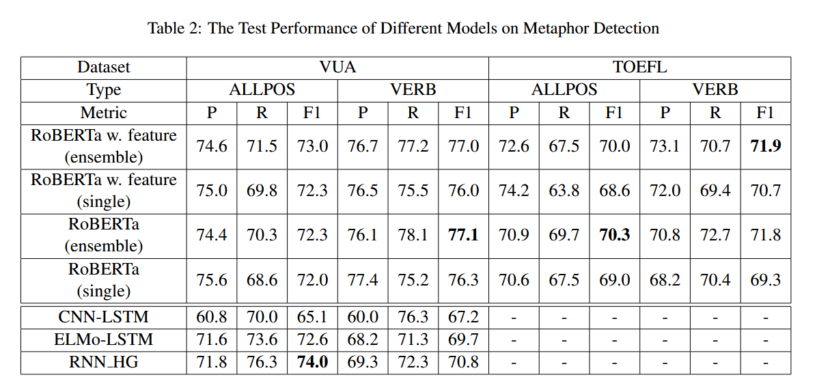
IlliniMet: Illinois System for Metaphor Detection with Contextual and Linguistic Information
This paper combines RoBERTa embeddings with linguistic features like WordNet for metaphor detection, evaluated on the VUA and TOEFL datasets. It achieved F1 scores of 73.0% (ALLPOS) and 77.1% (verbs) on VUA, and 70.3% (ALLPOS) and 71.9% (verbs) on TOEFL, showcasing robust performance across datasets.

Slide 11
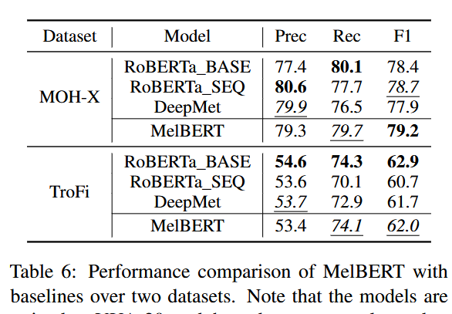
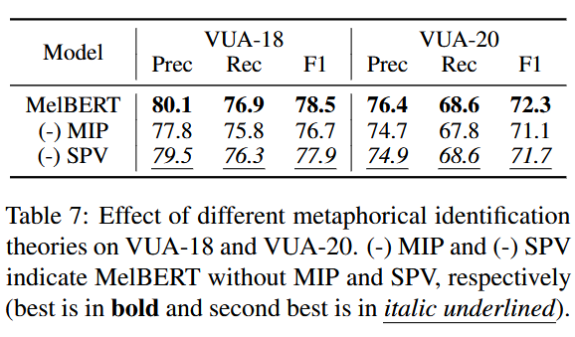
MelBERT: Metaphor Detection via Contextualized Late Interaction using Metaphorical Identification Theories
The MelBERT paper integrates linguistic theories like MIP and SPV with BERT embeddings using a late interaction mechanism to improve metaphor detection and generalization. Tested on the VUA, MOH-X, and TroFi datasets, it achieved F1 scores of 79.2% on MOH-X and 78.5% on VUA-18, surpassing baseline models.

Slide 12
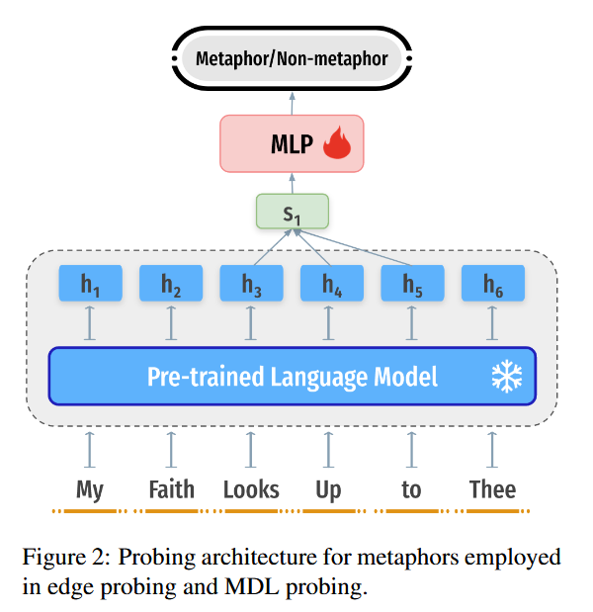
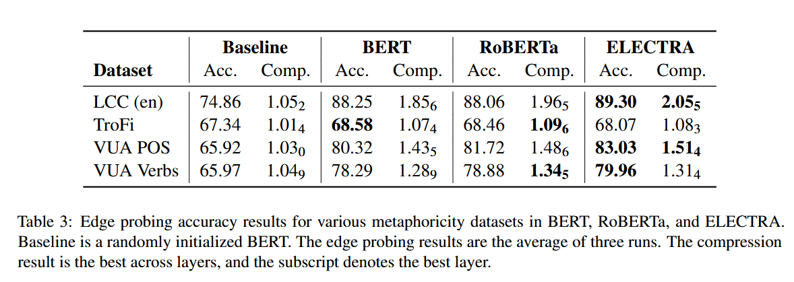
Metaphors in Pre-Trained Language Models: Probing and Generalization Across Datasets and Languages
The paper Metaphors in Pre-Trained Language Models evaluates pre-trained language models (BERT, RoBERTa, ELECTRA) for metaphor detection across various datasets and cross-lingual tasks. Tested on VUA, TroFi, and LCC datasets, ELECTRA achieved the highest accuracy of 89.3% on LCC and 83.03% on VUA POS, showcasing superior metaphor detection and cross-dataset transferability compared to other PLMs. The methodology utilizes the architecture shown in Figure 2.

Slide 13
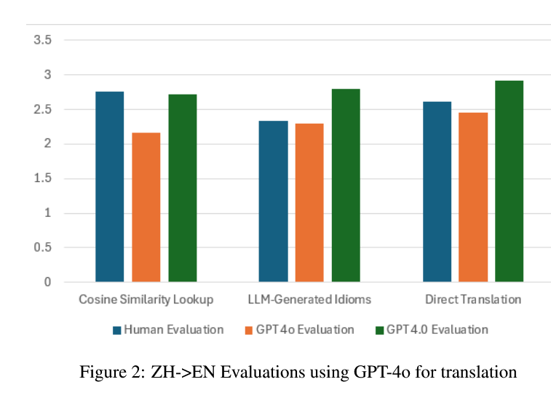
Comparative Analysis
Improving LLM Abilities in Idiomatic Translation
Cosine Similarity Lookup outperformed direct translations with GPT-4o achieving an average score of 2.761 for ZH → EN and 2.629 for EN → UR, demonstrating effectiveness in preserving idiomatic meanings.

Slide 14
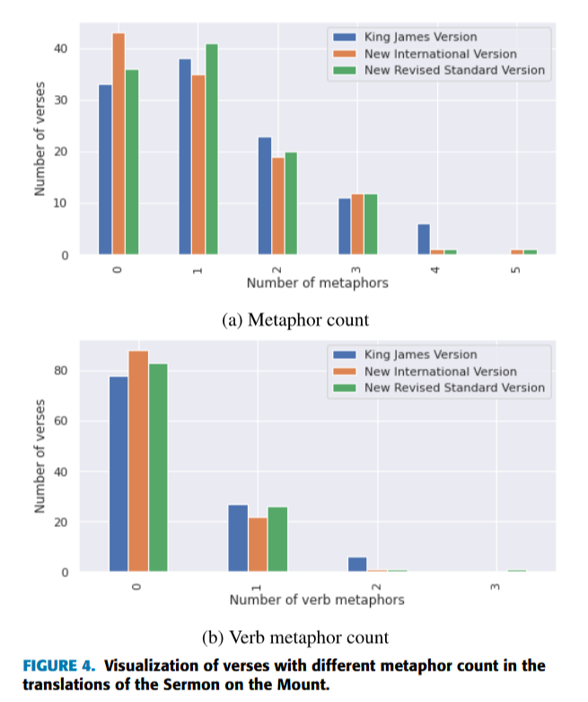
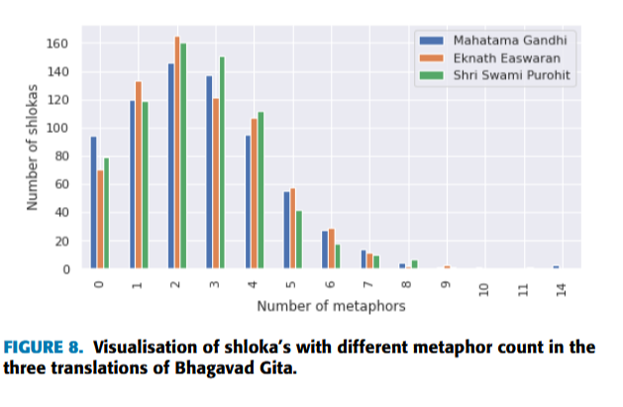
Comparative Analysis
Large Language Models for Metaphor Detection: Bhagavad Gita and Sermon on the Mount
The pre-trained LLM framework effectively identified complex metaphors in translations of religious texts, with qualitative analysis confirming fair consistency across translations despite differing vocabularies

Slide 15
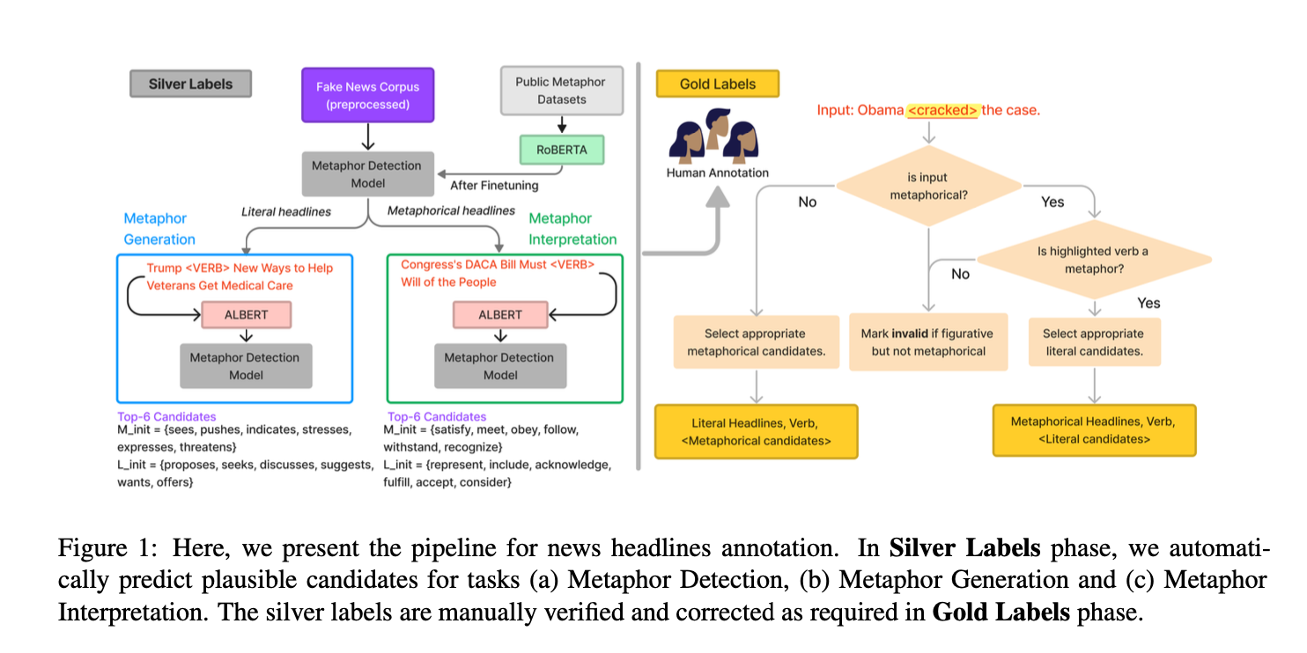
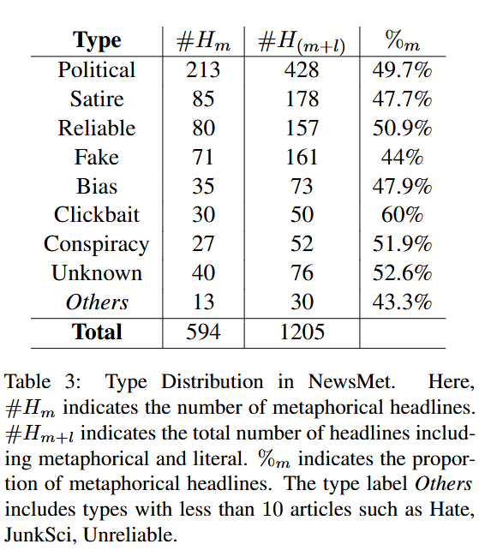
Comparative Analysis
NewsMet: A ‘Do It All’ dataset of contemporary Metaphors in News headlines
RoBERTa is fine-tuned on NewsMet Dataset for metaphor detection achieved F1 scores of 78% on literal and 76% on metaphorical sentences.

Slide 16
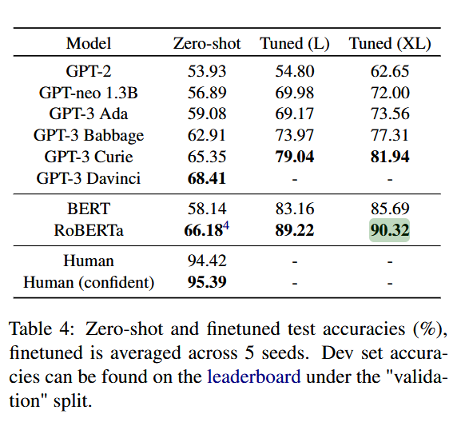
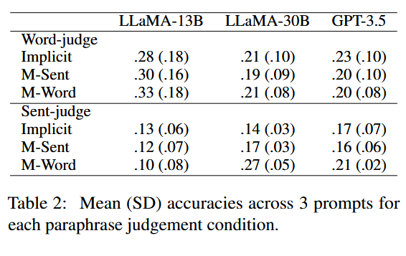
Comparative Analysis
Testing the Ability of Language Models to Interpret Figurative Language
Metaphor Understanding Challenge Dataset for LLMs
This paper Fine-tuned RoBERTa using the Fig-QA dataset and achieved the highest accuracy of 90.32%, nearing human performance (94.42%), but models still struggled with cultural metaphors.
Models like GPT-3.5 achieved a top recall of 32% and a mean reciprocal rank of 0.54 on the MUNCH dataset, highlighting challenges in metaphor understanding and paraphrase reasoning.

Slide 17
Comparative Analysis
Strengths:
MelBERT: Achieves high accuracy through the integration of linguistic theories like MIP and SPV into modern language models.
IlliniMet: Combines contextual embeddings from RoBERTa with linguistic features such as word concreteness, leading to enhanced detection capabilities.
GoFigure!: Improves metaphor detection through multi-task learning, leveraging idiom detection as an auxiliary task to boost model performance and reasoning.
Weaknesses:
Heavy reliance on annotated datasets significantly limits scalability, particularly for low-resource and underrepresented languages.
Lack of diversity in datasets hinders generalizability across languages, genres, and dynamic real-world contexts.
Current models are not robust in handling complex figurative reasoning tasks or evolving informal language trends in social media.

Slide 18
Critical Analysis
Evaluation of Research Quality
High-quality research advances metaphor detection and understanding.
PLMs like BERT and RoBERTa excel at contextual meaning.
Innovative models (e.g., MelBERT, GoFigure, FLUTE) achieve strong results.
Real-world datasets (e.g., NewsMet, MUNCH) enhance practical relevance.
Challenges remain in reasoning and adapting to unseen contexts.
Identification of Gaps
Limited progress in multilingual metaphor detection.
Models struggle with reasoning and deeper contextual understanding.
Datasets fail to reflect evolving metaphors in digital/social media.
Over-reliance on labeled data; limited generalization to new contexts.

Slide 19
Critical Analysis
Implications
Practical Implications
Improves machine translation and idiomatic expression accuracy.
Enhances sentiment analysis and sarcasm/irony detection.
Makes virtual assistants and chatbots more natural and human-like.
Theoretical Implications
Deepens understanding of metaphors and linguistic theories.
Simulates human metaphor comprehension in machine learning.
Contributes to computational perspectives on figurative language.
Limitations
Dataset bias toward English and specific figurative language types.
Limited application to conversational or literary language.
Models struggle with complex or novel metaphors.

Slide 20
Conclusion
Summary:
Significant advancements in metaphor detection using LLMs.
Persistent challenges in reasoning, multilingual adaptability, and dataset diversity.
Future Directions:
Develop multilingual models for low-resource settings.
Improve contextual reasoning using advanced semantic techniques.
Explore unsupervised methods to enhance adaptability.

Slide 21
Thank you!

